Slide 1
Segmentation vs Detection vs Classification in Computer Vision: A Comparative Analysis

Slide 2
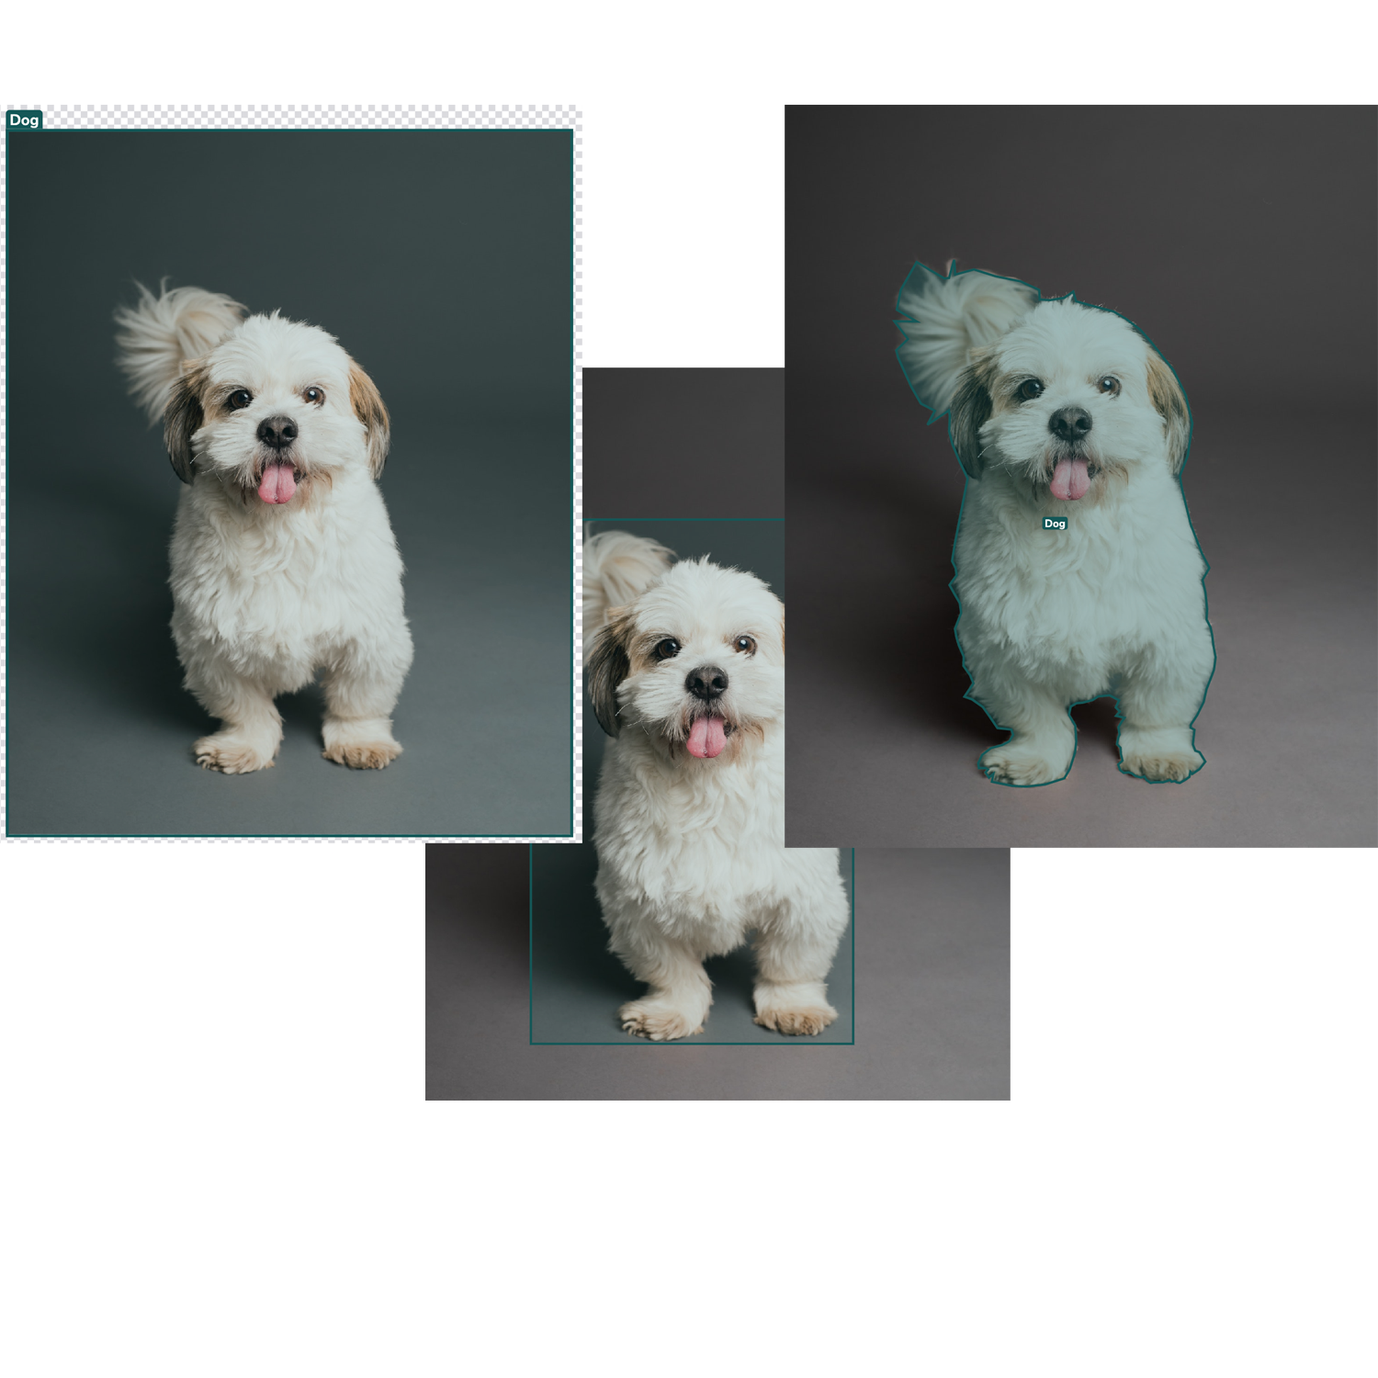

Slide 3
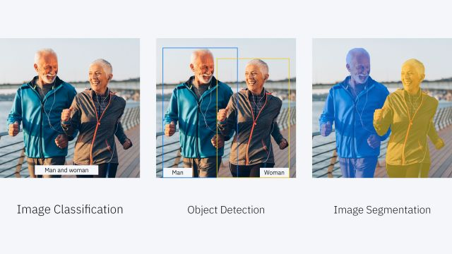

Slide 4
Computer vision is a vital component of today's technological landscape, enabling machines to perceive and comprehend the visual world. Within computer vision, three key tasks stand out: segmentation, detection, and classification

Slide 5
Understanding Segmentation
Segmentation is the process of partitioning an image or video into meaningful regions to identify and differentiate objects or regions of interest. It serves objectives such as understanding object boundaries, extracting fine-grained information, and enabling further analysis.
Segmentation techniques include semantic segmentation, which assigns class labels to each pixel, and instance segmentation, which identifies individual instances of objects. Panoptic segmentation combines semantic and instance segmentation, labeling all pixels while distinguishing different instances.

Slide 6
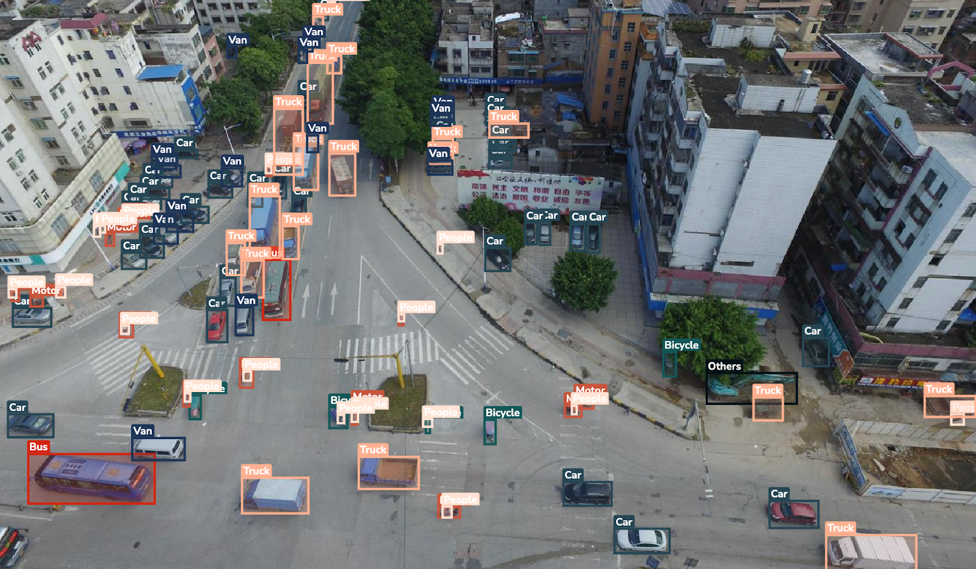
Exploring Object Detection

Slide 7
Object detection involves localizing and classifying objects within an image or video. It aims to identify specific objects of interest and provide their bounding boxes, crucial for tasks like object tracking and scene understanding.
Object detection comprises key components such as Region Proposal Networks (RPNs) for generating potential object proposals, feature extraction networks for analyzing proposals, and object classification networks for assigning class labels.

Slide 8
Popular object detection algorithms include Faster R-CNN, YOLO (You Only Look Once), and SSD (Single Shot MultiBox Detector). These algorithms differ in terms of speed, accuracy, and trade-offs, catering to specific application requirements.
Object detection finds applications in various fields, including video surveillance for identifying and tracking individuals or objects, agriculture for crop monitoring and pest detection, and retail analytics for customer behavior analysis.

Slide 9
Deep Dive into Classification
Classification involves assigning labels or categories to images or specific regions. It provides a holistic understanding of image content and can be approached through traditional or deep learning-based methods.
Traditional classification methods utilize handcrafted features and machine learning algorithms. However, deep learning techniques, particularly Convolutional Neural Networks (CNNs), have revolutionized image classification, achieving remarkable accuracy by automatically learning hierarchical features.

Slide 10
Popular classification architectures include AlexNet, VGGNet, and ResNet. Transfer learning and pretrained models leverage knowledge from large-scale datasets to solve specific classification tasks with limited labeled data.
Classification finds applications in tasks like image tagging and labeling, face recognition for identifying individuals from facial images, and disease diagnosis in medical imaging.

Slide 11
Comparative Analysis and Use Cases
Segmentation vs Detection:
When to Choose Each Segmentation excels in providing fine-grained information about object boundaries and regions. It is ideal for tasks like medical image analysis, manufacturing defect detection, and robotics object localization.
Detection, on the other hand, is suitable for identifying specific objects and their locations, making it prevalent in video surveillance, agriculture for crop monitoring, and retail analytics.

Slide 12
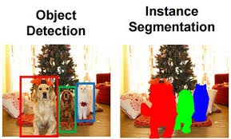

Slide 13
Detection vs Classification:
Differentiating Factors Detection provides not only class labels but also precise object locations through bounding boxes. It enables contextual understanding and interaction with the environment.
Classification, in contrast, focuses on assigning labels to images or regions. It is faster and more suitable for scenarios where fine-grained information is not necessary. Detection is preferred in augmented reality for real-time interaction with objects, while classification excels in tasks like image tagging and labeling.

Slide 14
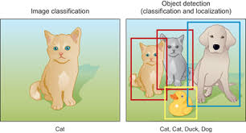

Slide 15
Combined Approaches:
Fusion of Segmentation, Detection, and Classification In advanced computer vision applications, a combination of segmentation, detection, and classification achieves higher accuracy and richer insights. By fusing the outputs, machines leverage the strengths of each approach.
For example, in autonomous driving, segmentation identifies drivable areas and objects, detection identifies specific objects like pedestrians and vehicles, and classification assigns labels for further understanding.

Slide 16
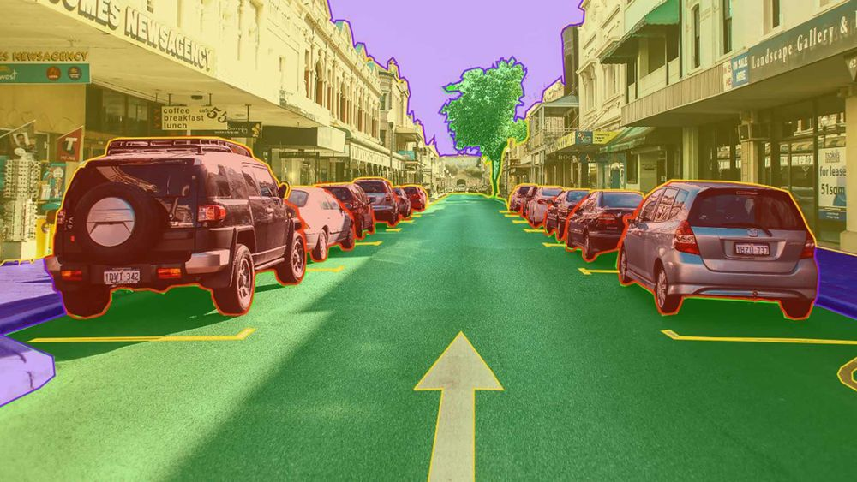

Slide 17
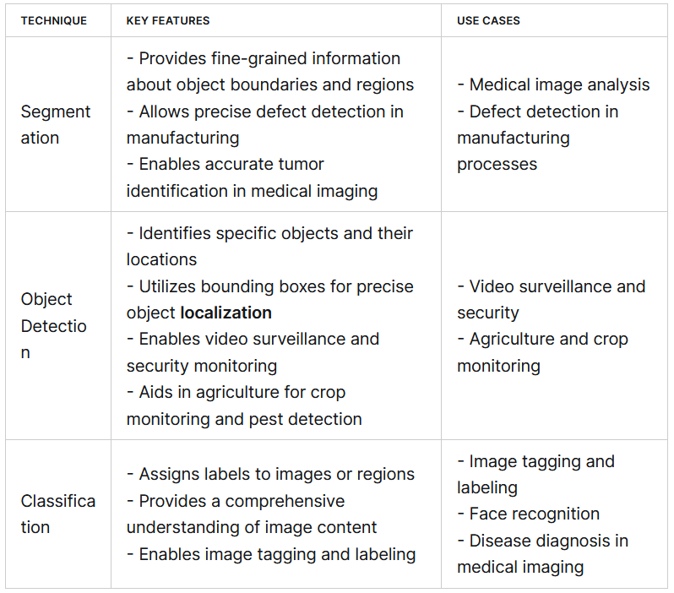

Slide 18
What is Feature Extraction?
Feature extraction is a process used in machine learning to reduce the number of resources needed for processing without losing important or relevant information. Feature extraction helps in the reduction of the dimensionality of data which is needed to process the data effectively. In other words, feature extraction involves creating new features that still capture the essential information from the original data but in a more efficient way.
When dealing with large datasets, especially in domains like image processing, natural language processing, or signal processing, it's common to have data with numerous features, many of which may be irrelevant or redundant. Feature extraction allows for the simplification of the data which helps algorithms to run faster and more effectively.

Slide 19
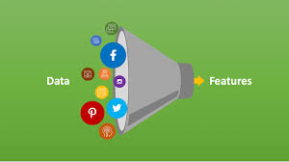

Slide 20
Data reduction aims to reduce redundancy in digital images thus saving crucial storage space and processing time. Usually dubbed as image compression, data reduction techniques find applications in multimedia, communications, remote sensing, and digital image databases.

Slide 21


